Slide 1

WeShipIt
IS 601 Final
Tracy Harrison
Mohammad Jilani
Mahum Abid

Slide 2
WeShipIt
IS 601 Final
Competitor Analysis
 | WeShipIt | UPS | USPS | FedEx
Service Quality | 4 | 5 | 3 | 4
Pricing | 3 | 3 | 4 | 4
Shipping | 4 | 3 | 3 | 4
Promotion | 4 | 5 | 5 | 5
Reputation | 2 | 5 | 3 | 5

Slide 3
WeShipIt ANALYSIS
SWOT Analysis
O
S
T
W
Add language options on landing page
More advertising to attract more customers
Easy navigation
Relevant content
Fast performance
Appealing color scheme
Good sign up workflow
Loyalty Program
Competitor may offer better website design/access
Government policies impacting design
Data/Privacy security
Company isn’t as large as it’s competitors
Website language limitations will deter customers
OPPORTUNITIES
STRENGTHS
THREATS
WEAKNESSES

Slide 4
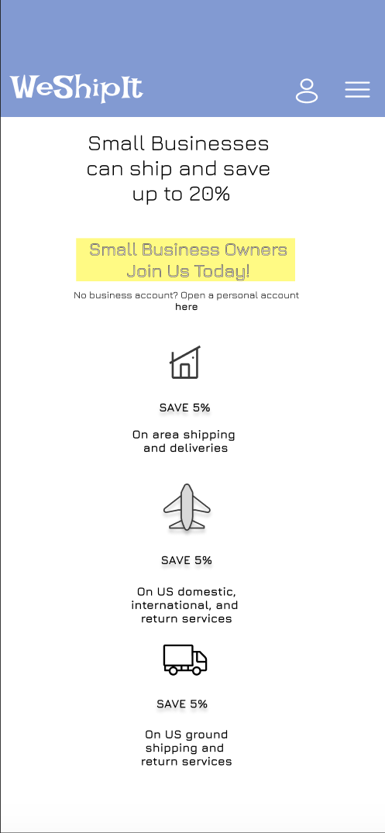
WeShipIt
IS 601 Final
Design Evolution
Our Initial Design For WeShipIt:
Used savings for small businesses as a means of persuasion, with a hero archetype depicted via the colors and font choices.

Slide 5
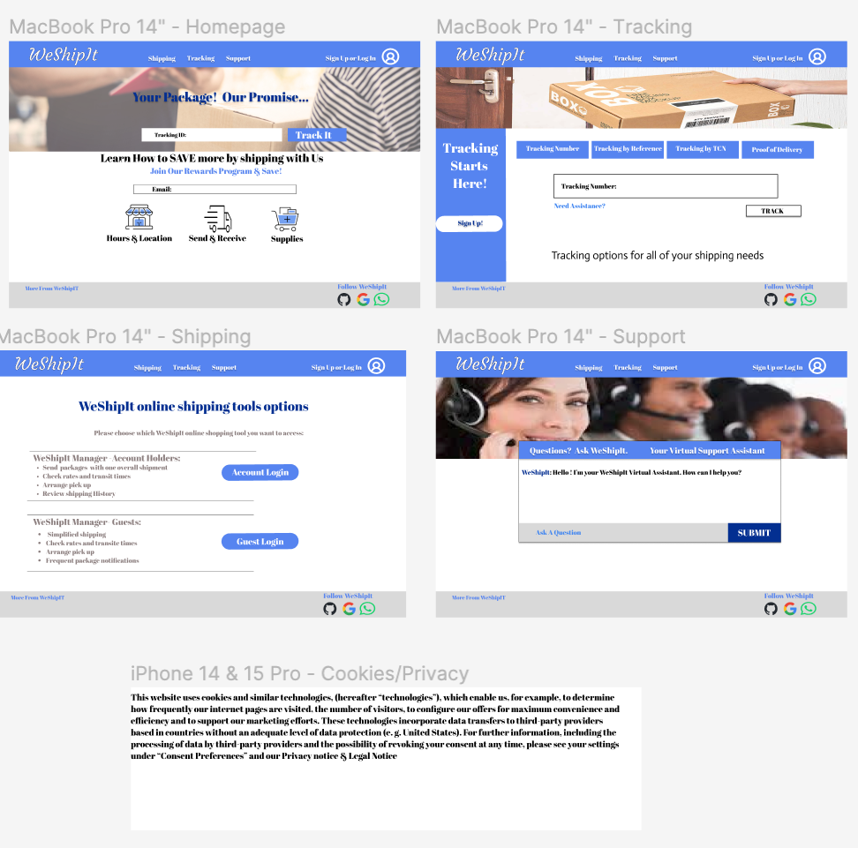
WeShipIt
IS 601 Final
Design Evolution Cont.
Our second design For WeShipIt:
Used a hero statement “Your Package! Our Promise” and loyalty program as means of persuasion.
Our hero archetype depicted via graphic choices, color schemes and font

Slide 6
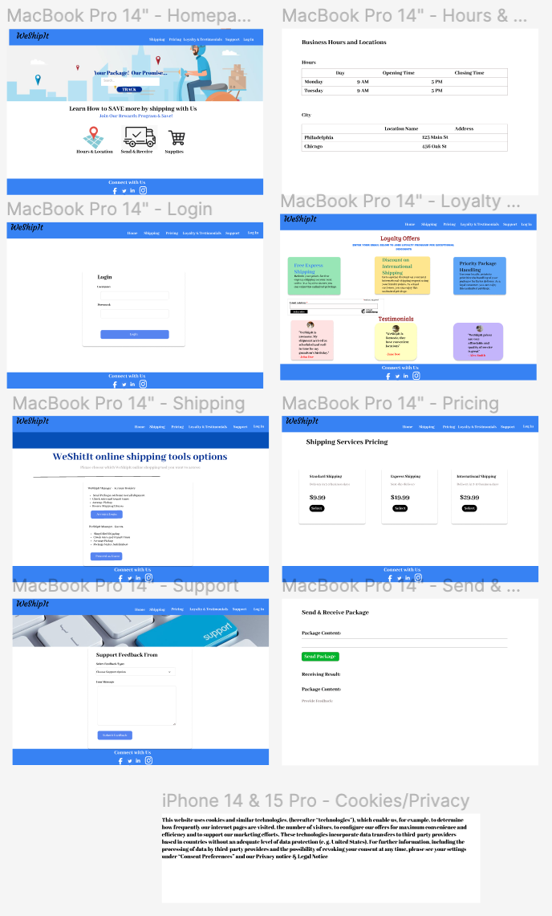
WeShipIt
IS 601 Final
Design Evolution Cont.
Our final design For WeShipIt:
We expanded the site to include more content.
Retained our hero statement “Your Package! Our Promise” and loyalty program as means of persuasion.
Our hero archetype depicted via updated graphics, color schemes and font

Slide 7
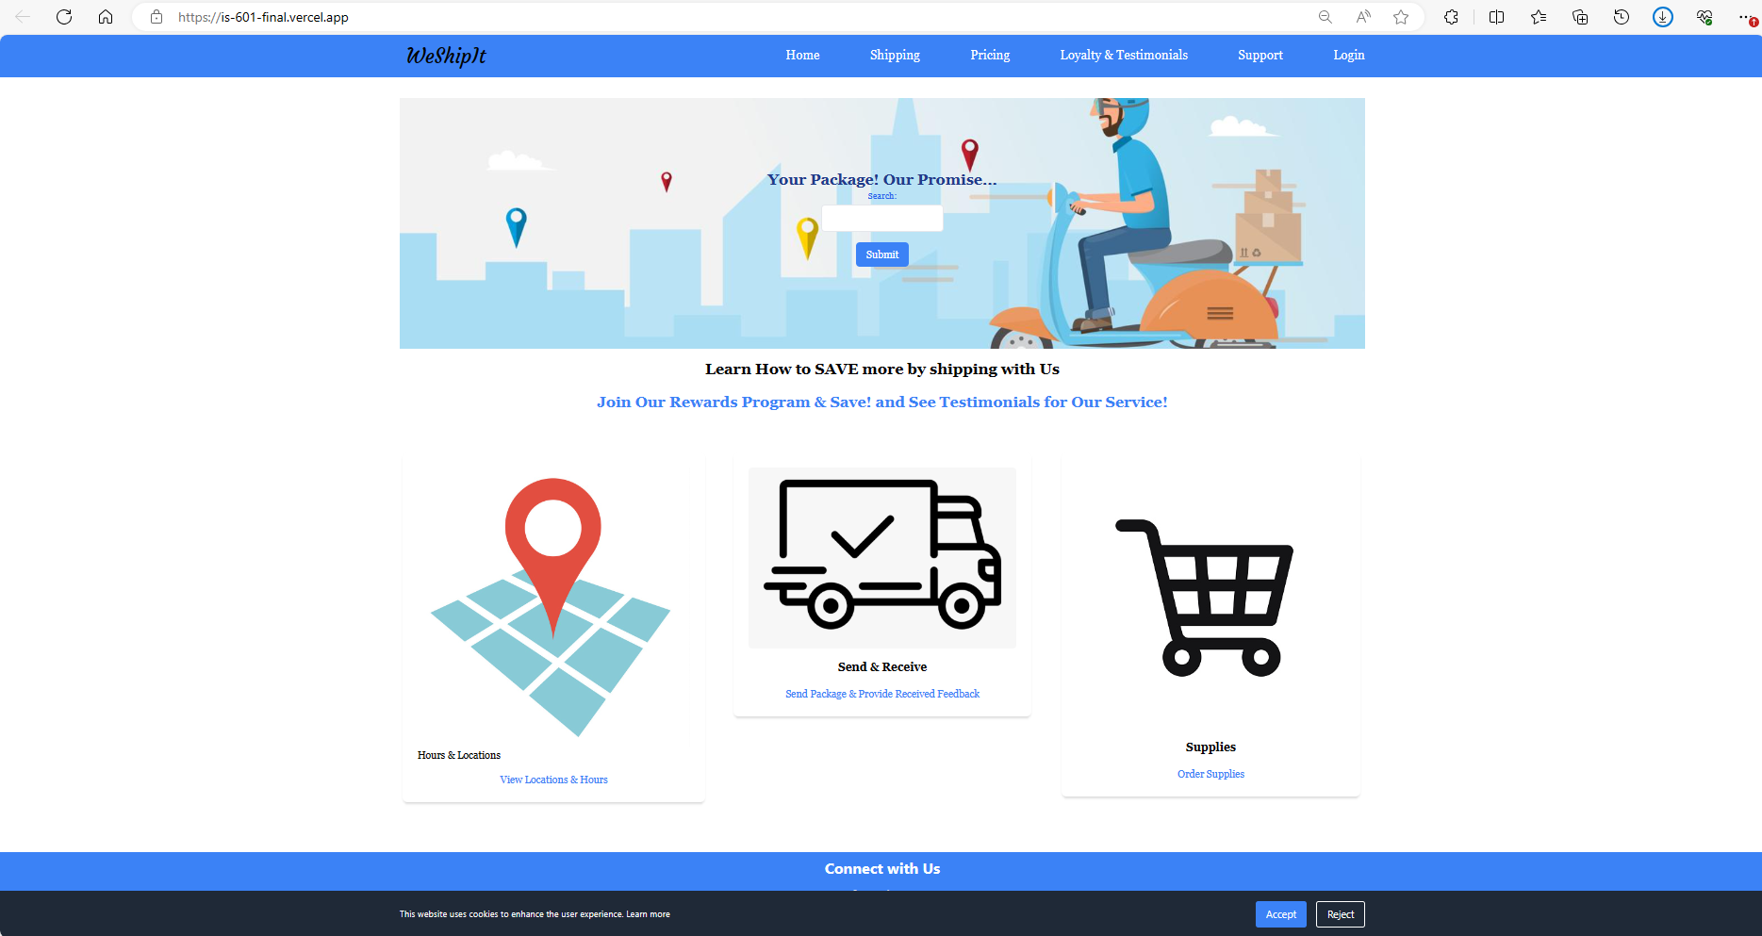


Slide 8
